Slide 1

INDUSTRIAL TRAINING
PRESENTATION
Submitted By:
Yash Saxena
Roll- 170111049
CSE CSF
Department of Computer Science and Engineering
DIT UNIVERSITY, DEHRADUN
(State Private University through State Legislature Act No. 10 of 2013 of Uttarakhand and approved by UGC)
Mussoorie Diversion Road, Dehradun, Uttarakhand - 248009, India.
2019

Slide 2

FACE RECOGNITON

Slide 3
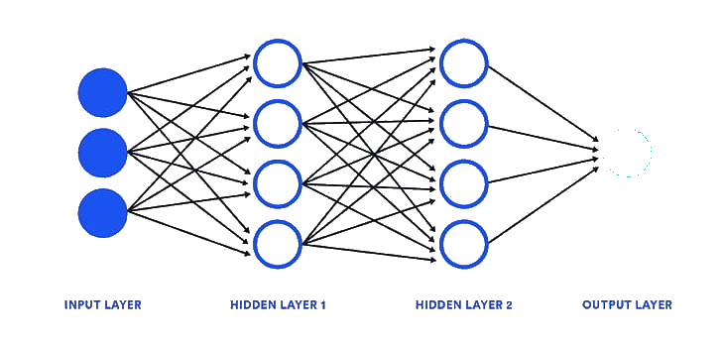
Deep Learning
Deep learning is a particular kind of machine learning that achieves great power and flexibility by learning to represent the world as a nested hierarchy of concepts, with each concept defined in relation to simpler concepts, and more abstract representations computed in terms of less abstract ones

Slide 4

Face Recognition
Facial recognition is a biometric software application capable of uniquely identifying or verifying a person by comparing and analyzing patterns based on the person's facial contours. Facial recognition is mostly used for security purposes, though there is increasing interest in other areas 4 of use. In fact, facial recognition technology has received significant attention as it has potential for a wide range of application related to law enforcement as well as other enterprises.

Slide 5
Project Intro
To develop a face recognition software which can run on low configuration system. We are developing our own app which can run in both Linux and Windows Environment.
The confidence level to detect the face of this software is 70-80%.

Slide 6


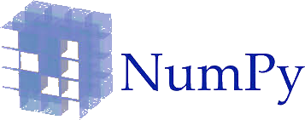
Project Architecture
They are many technologies and development architecture used in this project. They are listed below:
CV2(Open CV)
NumPy
Pyttsx3 (text to speech)
Python

Slide 7
Working
Using the webcam software will capture dataset of 100 images and will store them in a local folder.
Using an algorithm we will train the model to match the feature of face with the file of harcascade classifier. If everything is matched then it will show a message that face is detected.

Slide 8
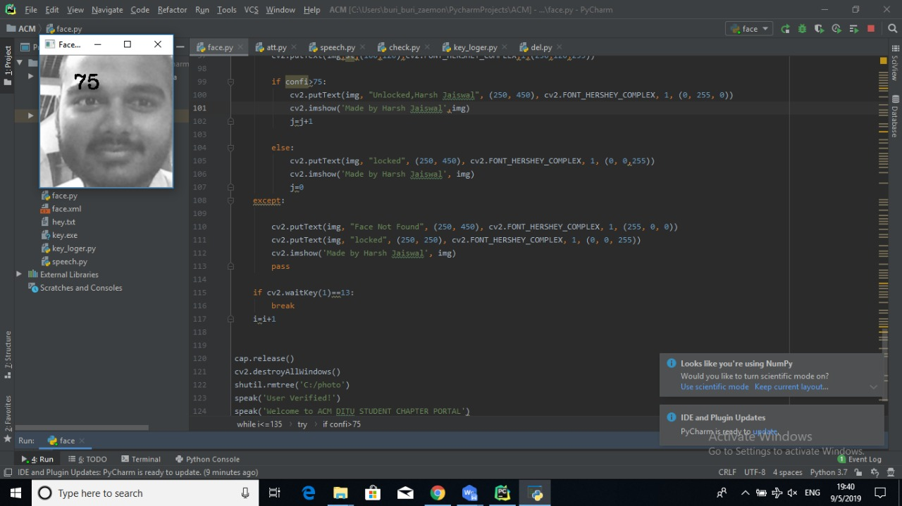
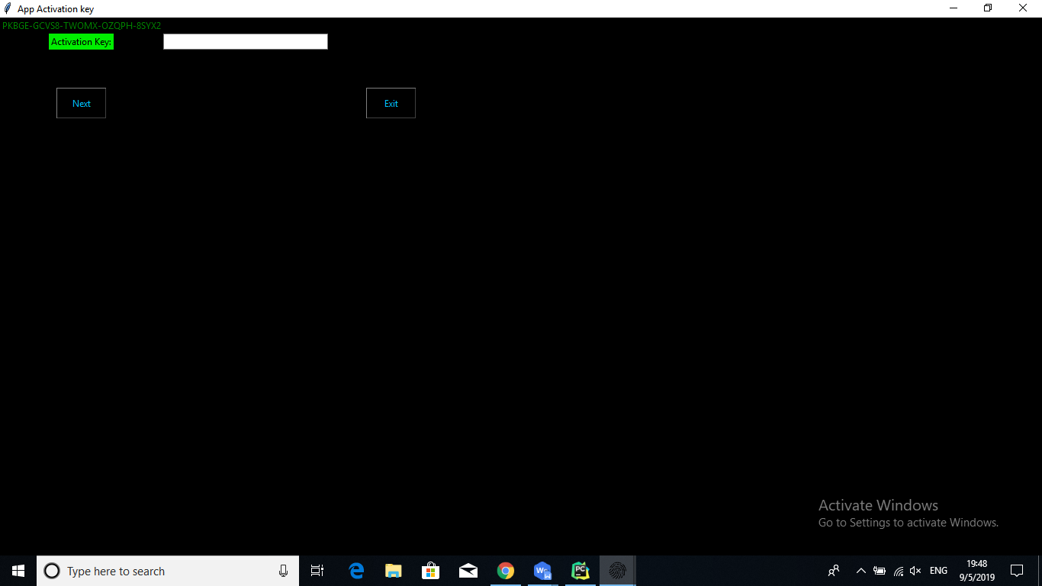
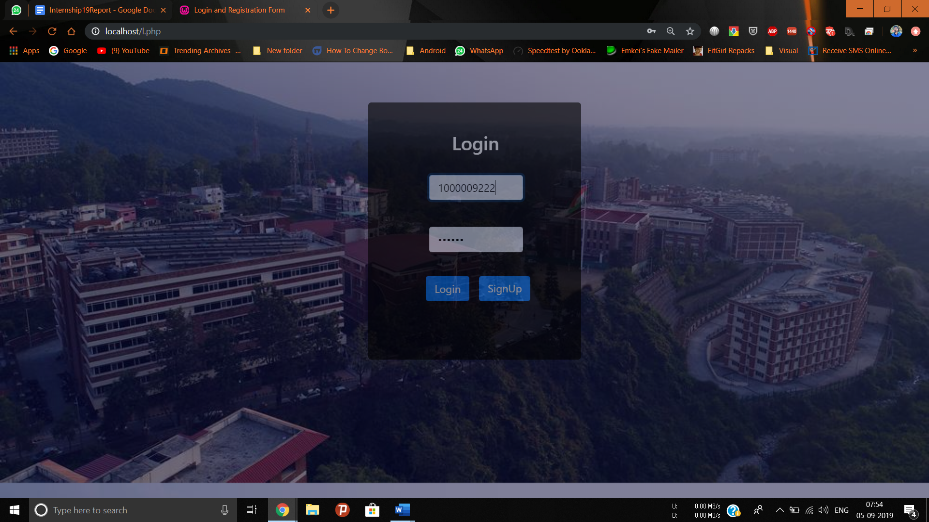
Process of capturing images is atsrated using webcam:

Slide 9
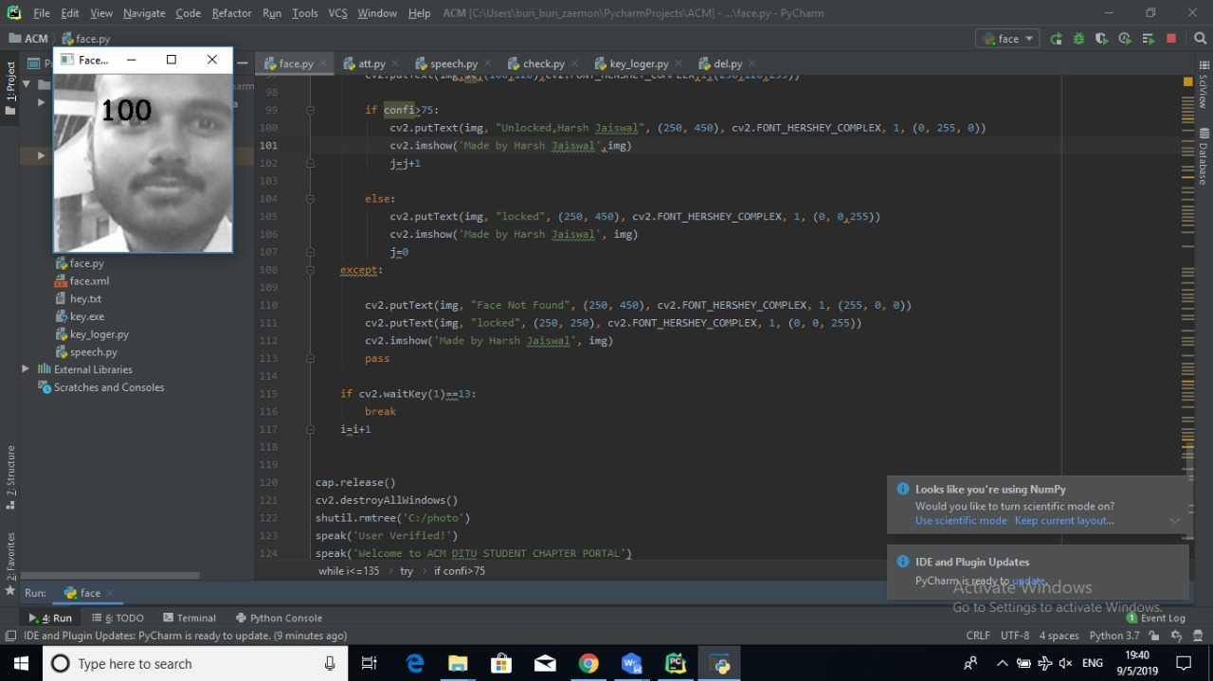
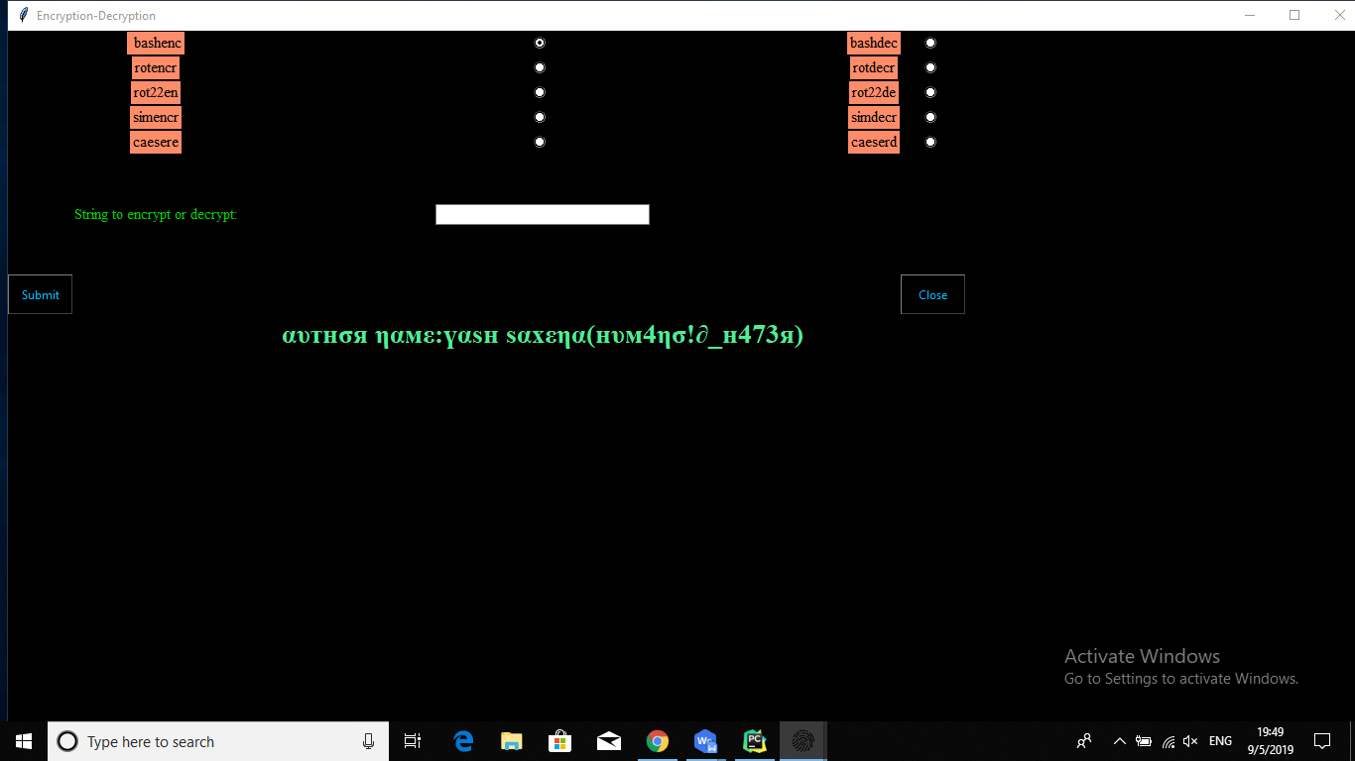
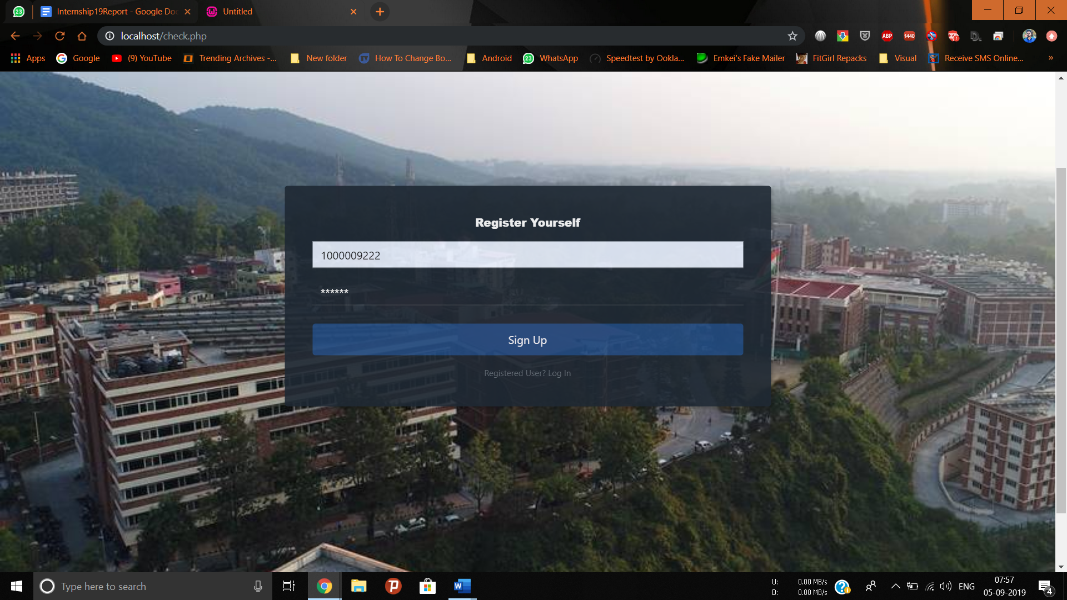
100 images captured successfuly and saved in a directory in C:\photo:

Slide 10
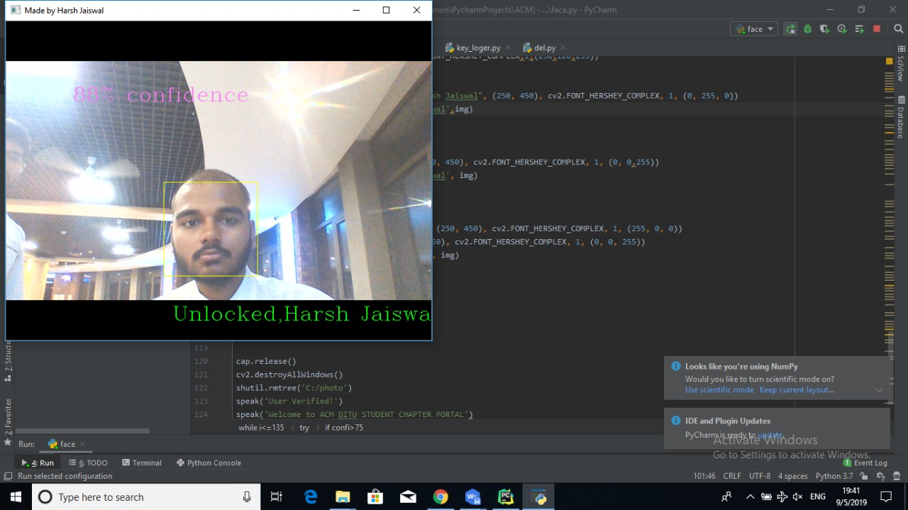
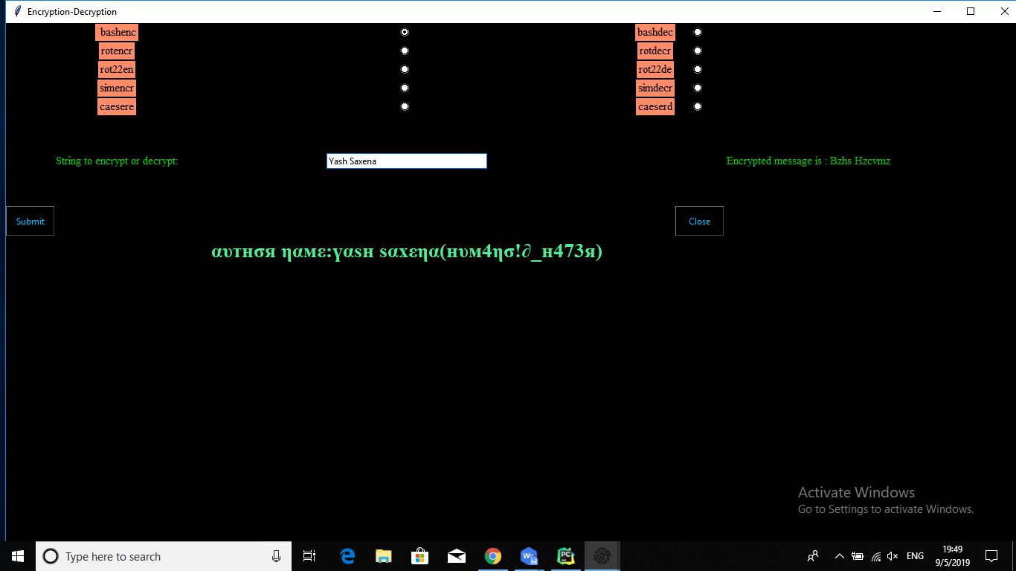
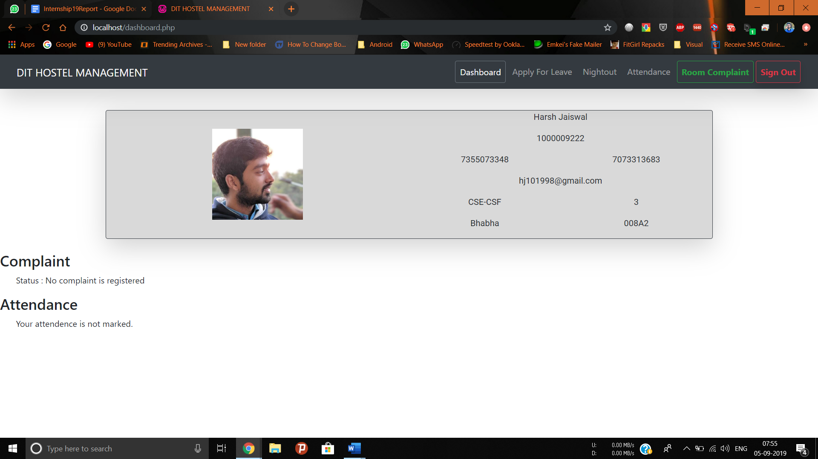
Model has been trained successfuly and it is able to recognise my face with confidence level of 71%:

Slide 11
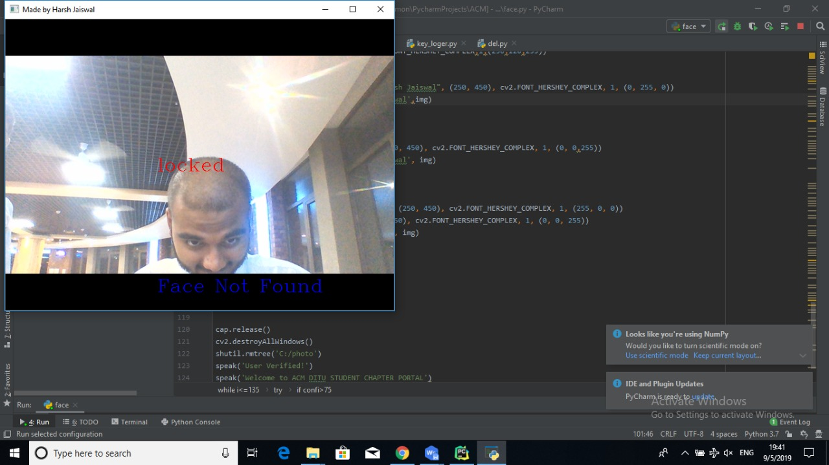

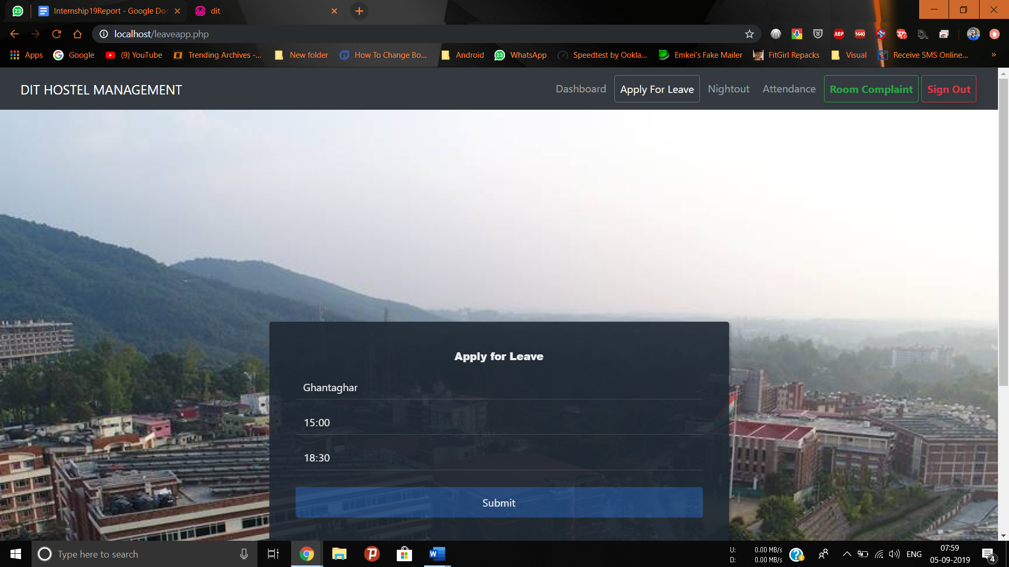
Here Model was not able to verify my face because face angle is changed:

Slide 12

Encryption & Decryption

Slide 13
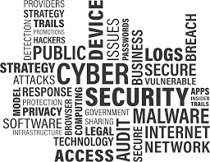
CYBER SECURITY
Computer security, cybersecurity or information technology security (IT security) is the protection of computer systems from the theft of or damage to their hardware, software, or electronic data, as well as from the disruption or misdirection of the services they provide.

Slide 14

ENCRYPTION
Encryption is the process of translating plain text data (plaintext) into something that appears to be random and meaningless (ciphertext). Decryption is the process of converting ciphertext back to plaintext

Slide 15
Project Intro
To develop an encryption software which can run on system. To decrease the chances of intercepting the plain text data and falling it into the wrong hands, we encrypt plain text into various types of encrypted text.
The drawback of this technique is that if a person knows the technique he can decrypt the encrypted text back into plain text.

Slide 16
Project Architecture
They are many technologies and development architecture used in this project. They are listed below:
Logging(Capturing logs)
OS (interaction with the system)
SMTP (Mail)
UUID (generate random object)
Python

Slide 17
Working
A plaint text is given as an input through a text box. It is passed through a encryption algorithm of your choice. After this stage the encrypted text is shown on the screen.
In Symmetric encryption it will ask a key that will be used to encrypt and decrypt that plain text.

Slide 18
User interface to enter the activation key:

Slide 19
Main interface of the software to select the method to encrypt or decrypt the data and a text box to input the string to encrypt:

Slide 20
Message encrypted successfuly and results is displayed in form of a label:

Slide 21
Message decrypted successfuly and results is displayed in form of a label:

Slide 22
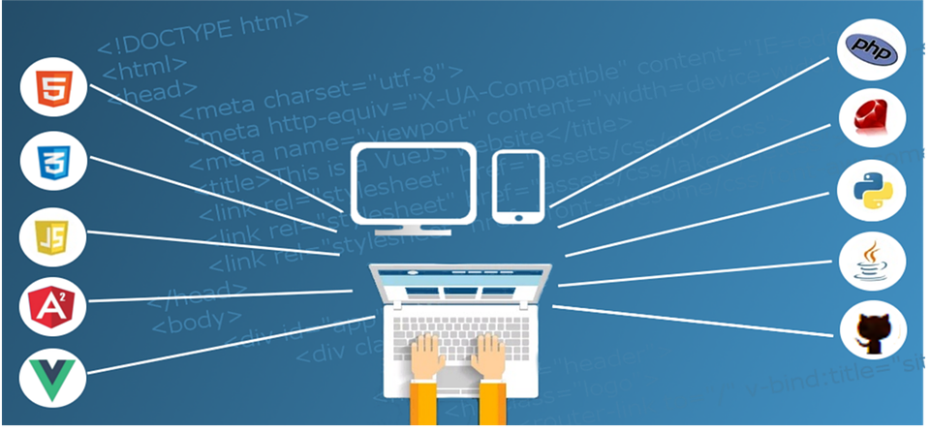
Dynamic Web App

Slide 23
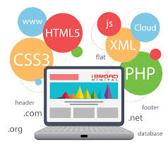
WEB DEVELOPMENT
Web development is the work involved in developing a web site for the Internet (World Wide Web) or an intranet (a private network). Web development can range from developing a simple single static page of plain text to complex web-based internet applications (web apps), electronic businesses, and social network services.

Slide 24
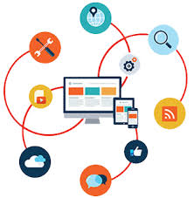
DYNAMIC WEB APP
Server-side dynamic web page is a web page whose construction is controlled by an application server processing server-side script in server-side scripting, parameters determine how the assembly of every new web page proceeds.

Slide 25
Project Intro
This web page is designed to minimize the usage of paper/register based attendance and leave application that are done on daily basis. It is targeted to Hostels/PG where attendance and applications are required on daily basis.
This web page has no boundation of time, a student can submit its leave/nightout request at any time and also warden can accept a students request at any time.

Slide 26
Project Architecture
They are many technologies and development architecture used in this project. They are listed below:
HTML (structure of this website)
CSS (designing of this website)
Bootstrap (responsive website)
PHP (backend services)
Php Mailer (Mail sending)
Text Local (API to send text messages)

Slide 27
Working
Sign up is required at first for a new individual. Log in page asks for Sap id and password(which is encrypted using SHA256).
Multiple features are provided-
Attendance
Leave application
Nightout application
Complaint

Slide 28
Login Page takes Sap id and Password from User:

Slide 29
Signup Page takes Sap id and Password from User:

Slide 30
Dashboard shows important details of the User:

Slide 31
Leave page takes Place and time from user:

Slide 32
Area of Improvement
There are a variety of enhancements that could be made to these projects to achieve greater level of security, usability and reliability.
We can increase the confidence level of the Face Recognition Software by using more classifiers such as eye, ear, hand, smile detection etc.
Extending the usage of Face Recognition Software by implementing it on hardware and using it in real life.
Adding more types of methods of encryption such as MD5, SHA256\512 hashing, also by using it in real life.
Improving the UX/UI of the website by adding animations and using materialistic design.
Improving the security of the page by using secure code and encryption techniques.

Slide 33
THANK YOU

